Slide 1
Pivotal Surgical Implant Placement Tool
Neuralink, US 2023/0157779, 5/25/2023
4/14/2024

Slide 2
Motivation / Background
Accessing data from single neuron in isolation is inaccurate -- need to access data from multiple neurons
Support circuitry with central unit is needed for accessing multiple neurons to increase sensor accuracy, but is fragile - not easily reparable post-implantaion
Need to consider alignment & stability factors for central unit
Conventional methods rely on technicians / physicians’ qualifications for performing procedures such as positioning implanted device (need $$$$ to hire!)
Need improved mechanism of brain implantations for better control & stability without risking damage to electrodes

Slide 3
Outline
Goal: Discuss brain implant apparatus with base member contoured to rest against cranium + ways how to place implant using tool
Embodiments:
Top perspective view of brain implant apparatus with cover
Top perspective view of brain implant apparatus without cover (1st configuration)
Perspective view of brain implant without cartridge and mount attachment (1st configuration)
Perspective view of brain implant (2nd configuration)
Top perspective view of brain implant apparatus with lowering assembly extended (2nd configuration)
Top perspective view of brain implant apparatus with implant positioned wthin implant placement site (back to 1st configuration)
Top perspective view of implant attached to cranium
Flowchart of procedure for implant placement inside cranium

Slide 4
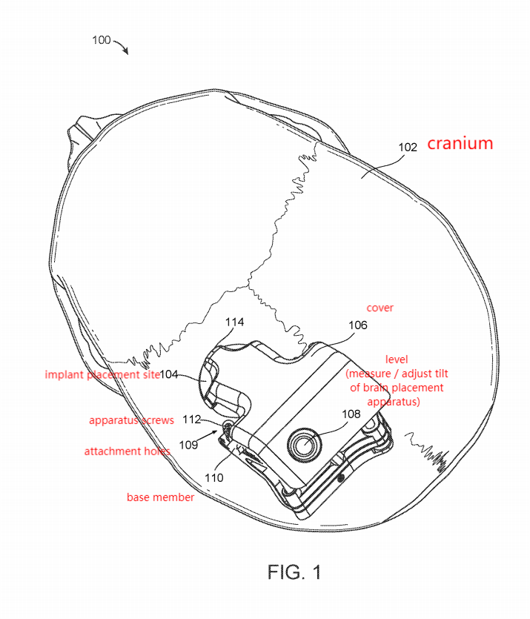
Top perspective view of brain implant apparatus with cover
Cover - transparent to brain to assist in positioning of brain apparatus relative to site
Level - measure / adjust tilt of placement apparatus

Slide 5
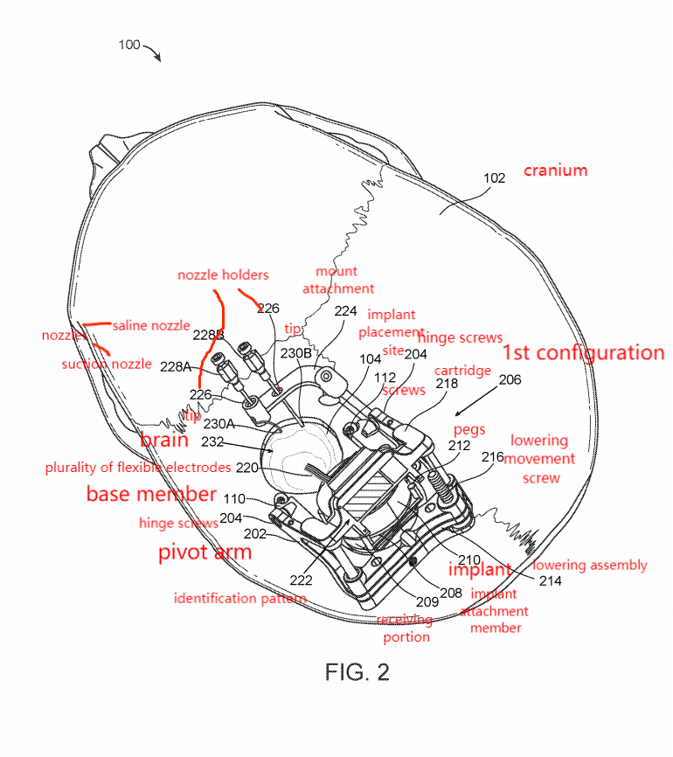
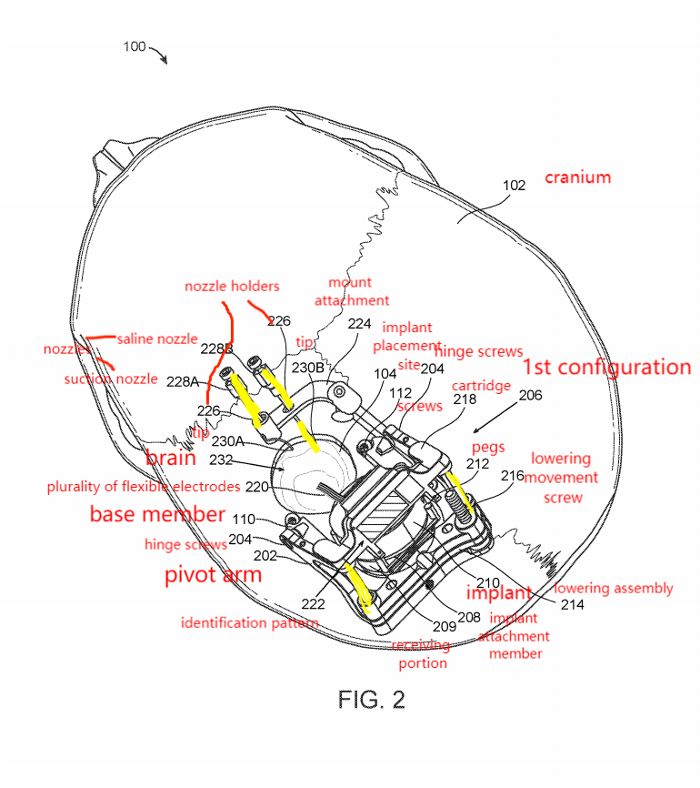
Top perspective view of brain implant apparatus without cover (1st configuration)
Pivot arm in 1st configuration - Embeddable portion facing upwards (pivot arm substantially above base member)

Slide 6
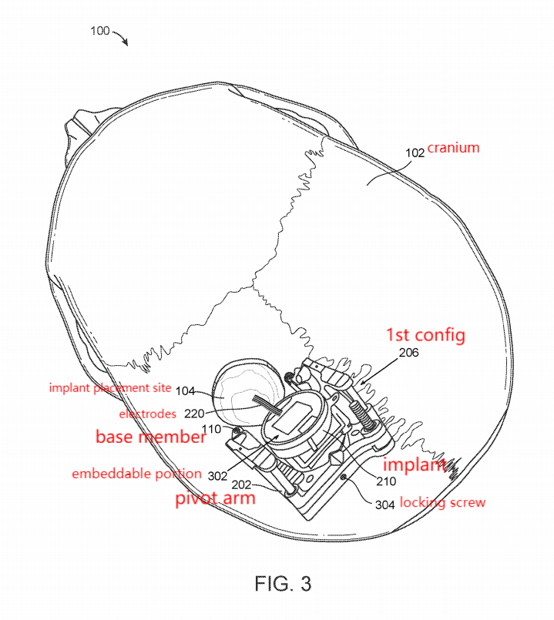
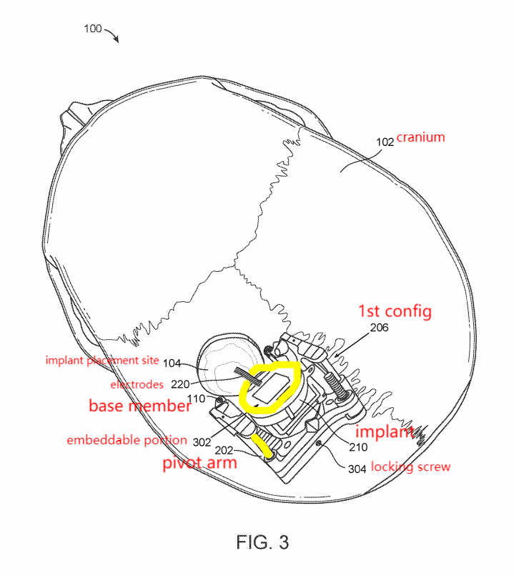
Perspective view of brain implant without cartridge and mount attachment (1st configuration)
Pivot arm in 1st configuration - Embeddable portion facing upwards (pivot arm substantially above base member)

Slide 7
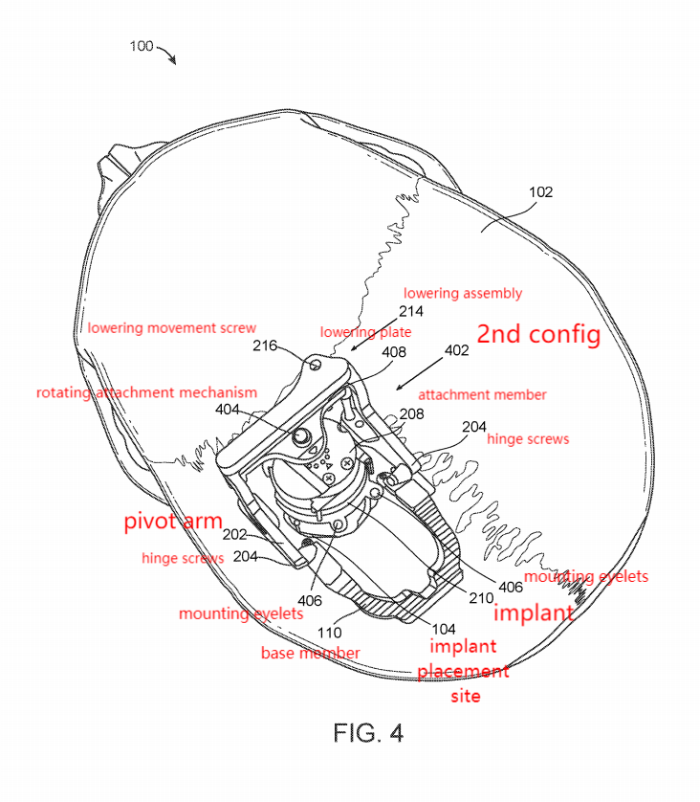
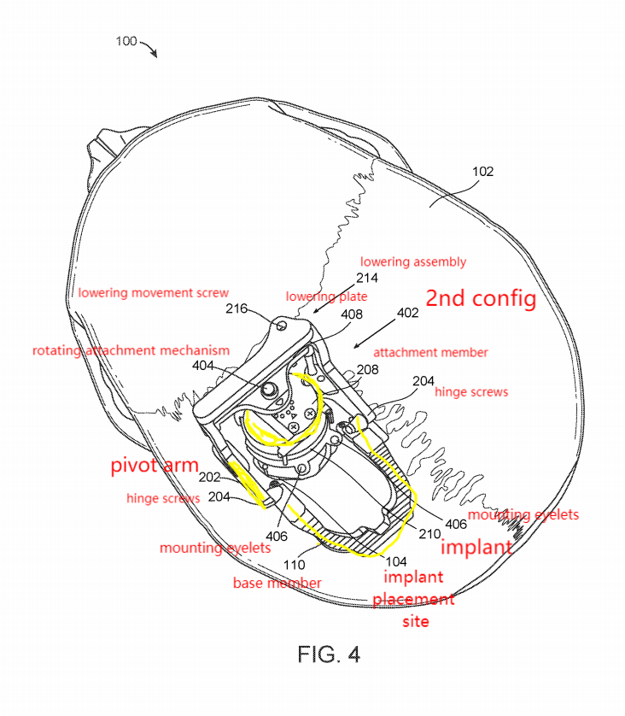
Perspective view of brain implant (2nd configuration)
Pivot arm in 2nd configuration - embeddable portion of implant facing downward (pivot arm moved down so implant is concentric with placement site)

Slide 8
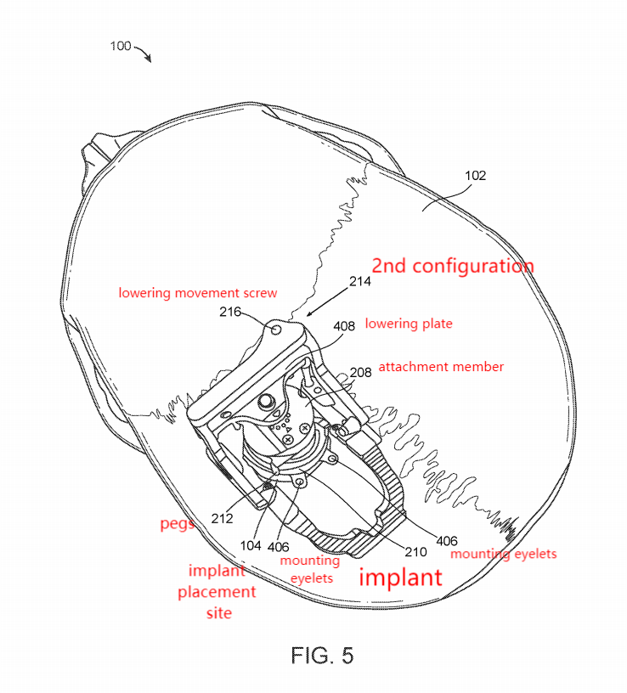
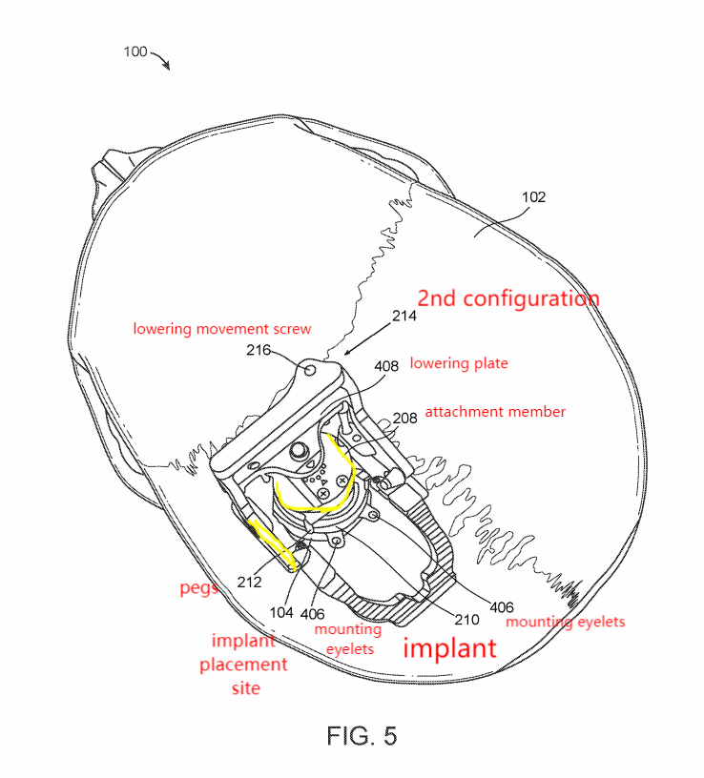
Top perspective view of brain implant apparatus with lowering assembly extended (2nd configuration)
Pivot arm in 2nd configuration - embeddable portion of implant facing downward

Slide 9
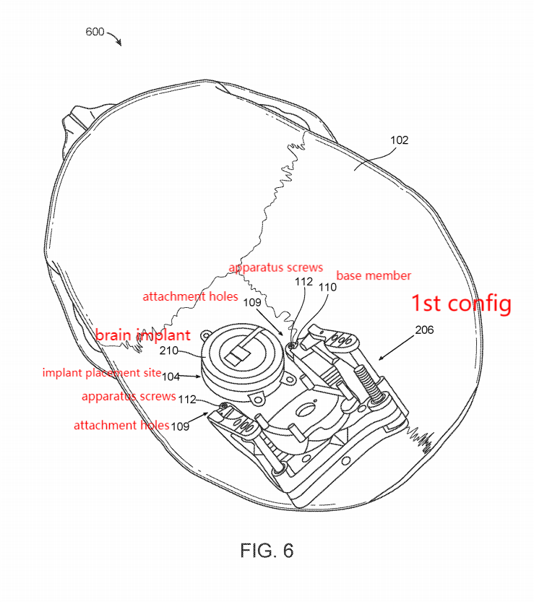
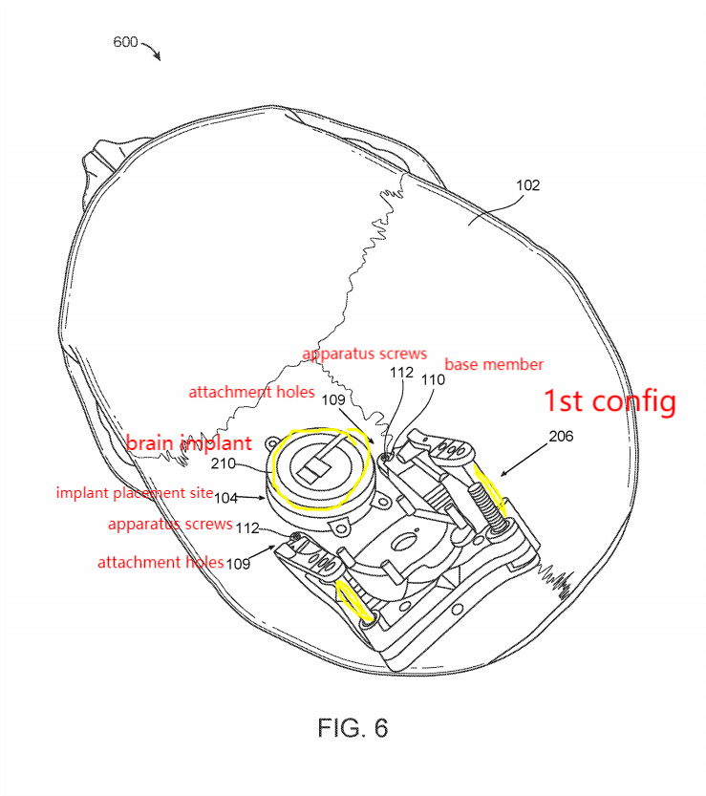
Top perspective view of brain implant apparatus with implant positioned wthin implant placement site (back to 1st configuration)
Pivot arm in 1st configuration - Embeddable portion facing upwards

Slide 10
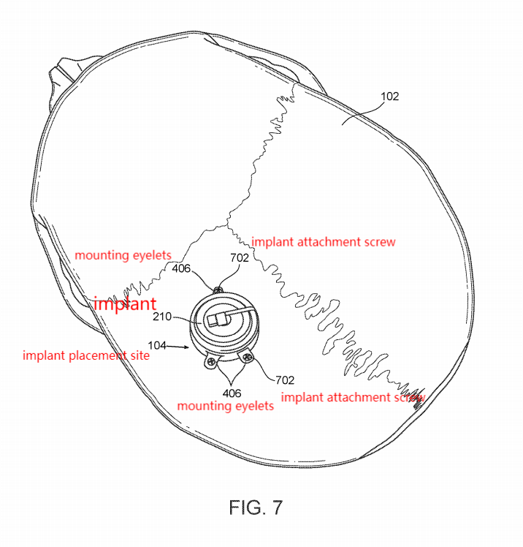
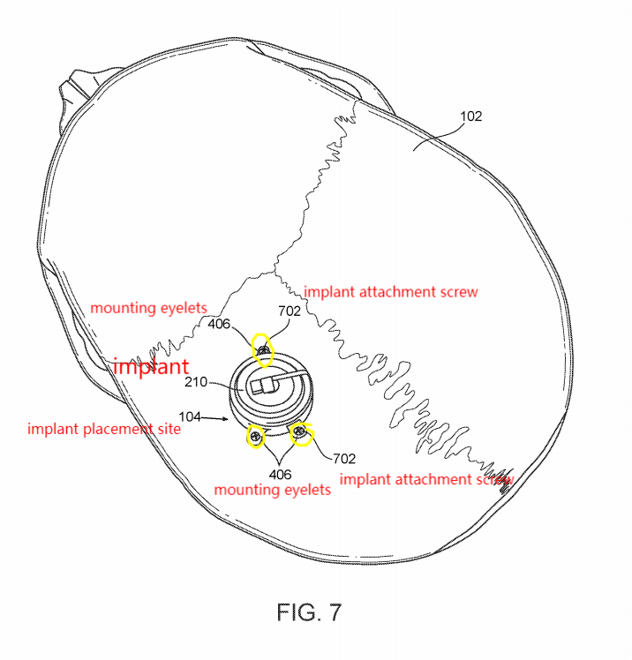
Top perspective view of implant attached to cranium
Brain implant is secured by insert 1+ biocompatible implant attachment screws through mounting eyelets

Slide 11
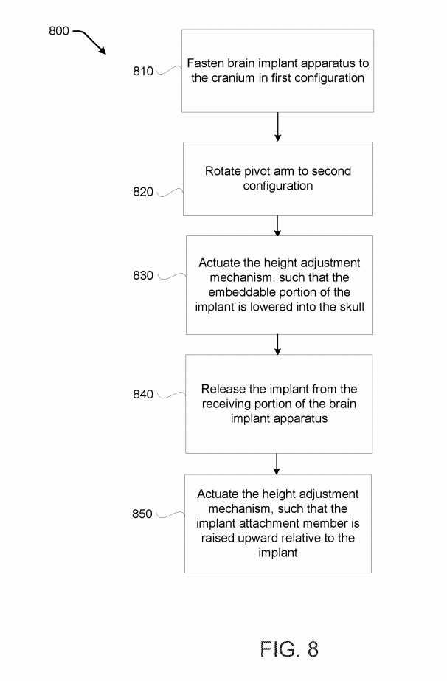
Procedure - Implant placement on cranium

Slide 12
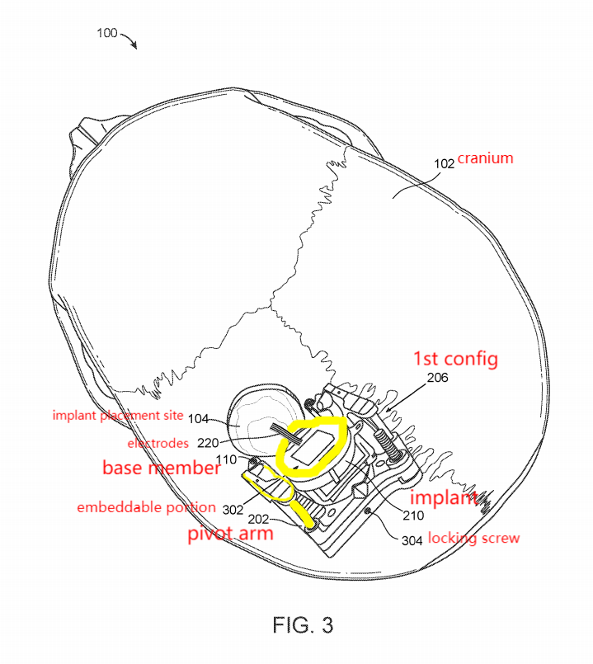
Step 1:
Attach base member to cranium via biocompatible screws
Need to determine tilt angle + position on cranium

Slide 13
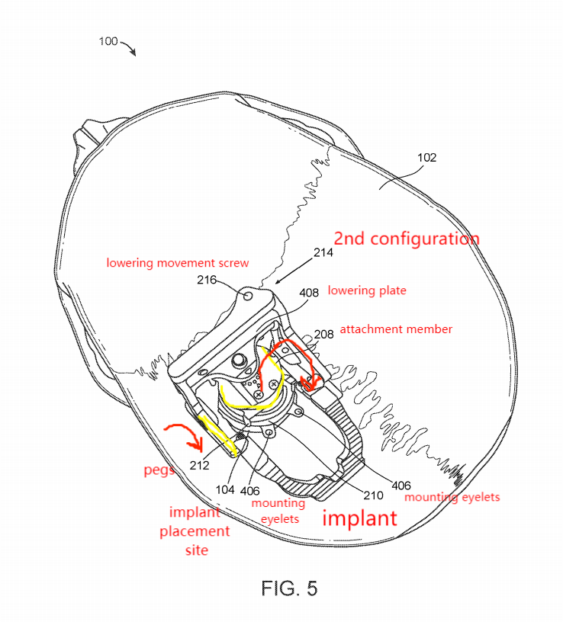
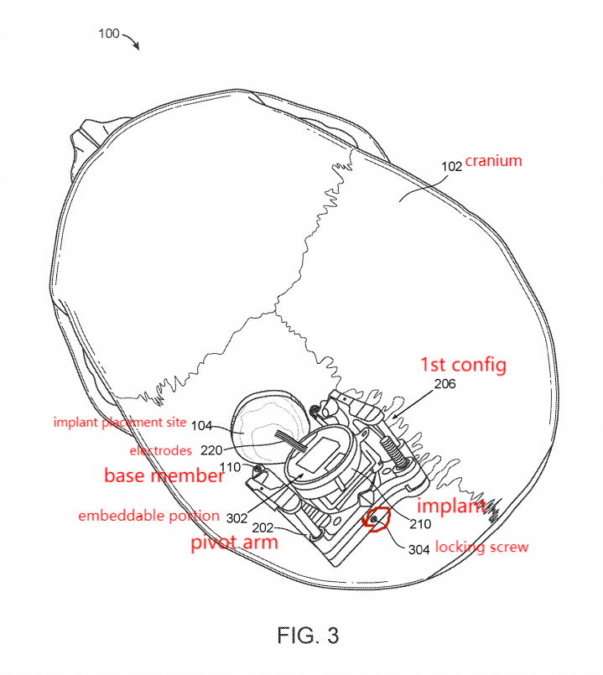
Step 2:
Can disengage locking screw before rotating pivot arm

Slide 14
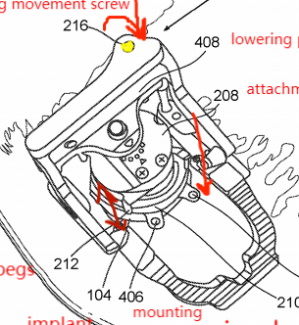
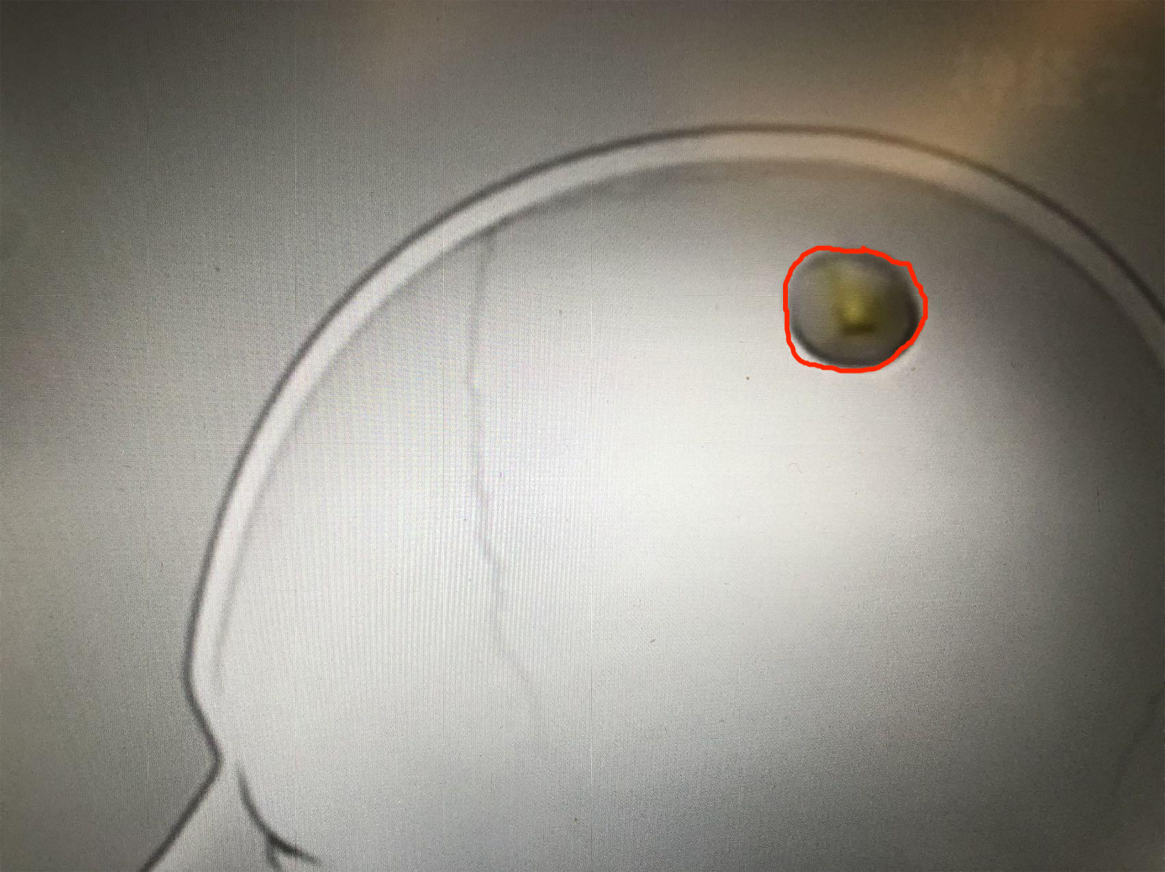
Step 3:
Can be achieved by rotating a screw such that a distance is created between receiving portion and pivot arm
Can also achieve via sliding mechanism with lock to prevent height adjustment when not actuated

Slide 15
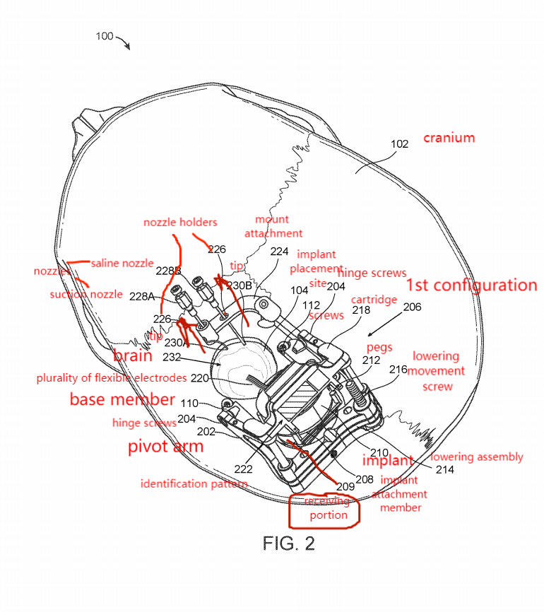
Step 4:
Can be removably attached by receiving portion of the brain via friction, magnetics, adhesives, screws, etc.
Can be released using screwdriver

Slide 16
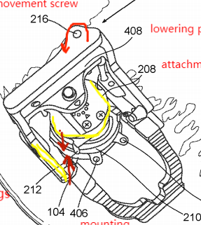
Step 5:
Can be achieved by rotating a screw such that a distance is reduced between receiving portion and pivot arm (opposite from step 3)
Can also achieve via sliding mechanism with force opposite to step 3

